Slide 1
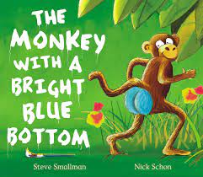
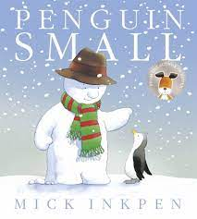
Spring 1 Reception: Ticket to Ride.
You can access our key books either at the library or listen to the story being read via Youtube.
Key books this term
Key Vocabulary
fierce: displaying aggressiveness
zoo keeper: an animal attendant employed at a zoo.
Fragile: easily broken or damaged.
Grumpy: bad tempered and irritation
Perfect: absolute, complete.
Camouflage: hide or disguise
Primate: diverse order of mammals
Key Questions?
-Why was the elephant not a good pet?
What was the giraffe too tall for?
Why was the lion sent back to the zoo?
Do you think a grumpy camel would make a good pet? Why not?
Which animal would be the hardest to look after?
If you could choose any animal for a pet, which one would you choose and why?
Key Vocabulary:
entranced- watch, filled with wonder and delight.
elegant- graceful and nice looking.
clumsy- moving in awkward ways, bumping into things.
sneered- to laugh at someone and have an unkind look on your face.
clearing- an opening in the trees that allows you to see the sky.
Key Questions?
-What was Gerald good at?
-Why did Gerald think he was bad at dancing?
-Why does Gerald feel sad that he can't dance?
-Should Gerald feel sad?
-Is being a good dancer important?
-Should the other animals make fun of Gerald for not being able to dance?
Key Vocabulary:
Bolder – feeling braver, more confident.
Leap – a big jump from one place to another.
Spectacles – a pair of glasses.
Fainted – to lose consciousness (as if asleep) through shock, fear or stress.
Key Questions?
Why did the monkey wait until the animals were asleep to paint them?
Why did the monkey leap into the tree?
What was the monkey scared of?
How did the monkey feel when the bear woke up?
Do you think the monkey enjoyed painting the animals? Why?
Key Vocabulary:
terrified – cause to feel extreme fear
Icicle – a hanging piece of ice
Eskimos – a member of an indigenous people
Antarctica- the south polar region
Arctic- the north polar region
-Key Questions?
What couldn’t the penguin do? Why? Is there anything that you can’t do?
Where did the penguin and the snowman float to? What was the difference between the 2 places?
The snowman couldn’t speak. How do you learn new words?
Which people might you find living in the polar regions? What animals might you find there?
Key Vocabulary:
tea- a meal eaten in the afternoon.
Grocer- a person who sells food
Supper- a small evening meal
Café- a small restaurant
Key Questions?
What did the tiger eat at afternoon tea?
Did the tiger know he was being greedy?
Is it okay to walk into someone’s house and eat there food? Explain your answer.
What do you think the tiger will do next (at the end of the story)?

Slide 2
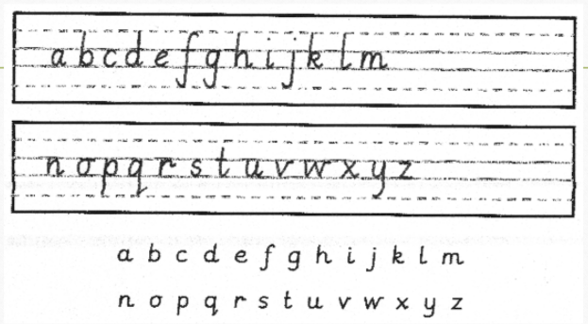
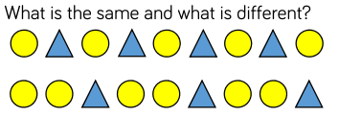
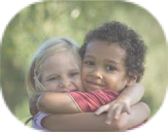
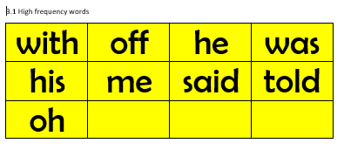
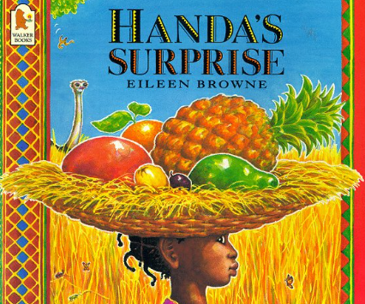
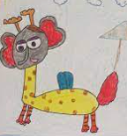
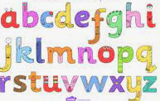
Physical development
Mathematics
Understanding the world
.
Letter formation:
This is an important skill in learning to write. We continue with our handwriting sessions in class and will be sending home sheets to practise letter formation at home.
Please encourage your child to hold their pencil correctly using a tripod grip.
We follow the White Rose scheme for maths, incorporating numicon and number blocks to support our maths.
This half term we are securing our knowledge and understanding of numbers 0-10. We will look at number bonds to five and ten and which numbers we can add together to create a new total. We will order numbers to ten and compare numbers using more/less/fewer. Then we will move on to exploring 3D shapes and creating patterns.
:
Coats and zips If your child can not yet zip up their own coat, please keep practising with them at home. We know that sometimes winter coat zips can be tricky.
The natural world
We are very excited to be taking the children to the Yorkshire Wildlife Park (Thurs 23rd March) to consolidate our learning about animals. In class, the children will have learnt about many of the animals that we will see- those that live in hot countries, cold countries and they will know specific facts and adaptions that animals have.
People and Communities
We will be using stories like Handa’s Surprise to explore how lives of people in other countries (particularly African countries) differ from lives in the UK.
This half term will also bring our ‘Mother’s Day’ (special people/carers/grandparents) celebrations. This will be taking place in Class 6 & 7 on Friday 17th March at 2.15om.
PSED
Expressive arts and design
English
One of the best things you can do to help children learn to read is to drop the /uh/ sound when saying a letter sound. The technical term for this is a 'schwa' and avoiding adding it to the end will mean you are using the 'pure sound'. The common phonemes where an /uh/ is unnecessarily added are:
mmmmm not muh
ssssss not suh
llllll not luh
rrrr not ruh
p p p not puh
Modelling the 'pure sounds' means that it is easier for children to push them all together to form the word. So, instead of saying 'suh', 'u', 'nuh' use 'ssss', 'u', 'nnnn' to make the word 'sun'.
Listening to adults use the correct pronunciation also means that children are more likely to say the sounds correctly and this gives them a greater chance to blend them to form words independently.
Art and Design
We will be having fun creating mixed up animals on Switchzoo.com and then creating our own mixed up animals using paints, pens, crayons, pastels (children’s choice)
Jigsaw We follow a scheme called Jigsaw to focus on building positive relationships and develop self esteem in learning. It links well into our Early Years curriculum (EYFS). The topic focus for this half term is ‘Healthy Me”. This encourages the children to think about what can keep them in good health.
Writing: Children will become more independent in writing simple sentences and captions. We will continue to write for different purposes- lists, captions, posters, stories etc. The children will practise writing the tricky words matched to our reading scheme.
Tricky words: Ideally children should now be moving on to the yellow key words. If they aren’t, please don’t panic. Tricky words are words that can not be sounded out and need plenty of practise to read. Games such as matching pairs or snap can help move the children on. Constant exposure through placing words on the stairs, cupboard doors, in the bathroom can also really help your children read and recognise them. If you would like any extra sets of words or more game ideas please just ask.
Music
We will be: We will continue following a music scheme called Charanga. This half term we will be listening to and appraising music about our world including songs about planets and oceans. we will be singing and playing along using instruments. We will be learning to keep the beat by clapping, and keeping a beat using an instrument such as a drum or a triangle.
Sounds:This half term we will be recapping Phase 3 sounds which include digraphs and trigraphs. We will use this terminology with the children. Digraphs are 2 letters that make 1 sound (ee, ai, ow etc.) and trigraphs are 3 letters that make 1 sound (igh, ear, air, etc). It is important for the children to spot digraphs and trigraphs in words that they can read by sounding out.
AT HOME:. Talk through the children’s everyday routines which contribute to keeping them healthy: sleeping, brushing teeth, having a bath, eating fruit and vegetables, exercising etc.
AT HOME: Practise your reading book, key words and sounds as often as you can. Please bring your book bag and reading diary everyday.
AT HOME: Link together animals and mothers day by reading books with your child about animal mothers and babies – learn the names of the babies e.g. mare and foal, cow and calf, cat and kitten etc.
AT HOME: Make an instrument out of junk modelling.
Remember to log any home learning onto Seesaw. If you need reminders of your login details, please get in touch with your child’s class teacher.

