Slide 1
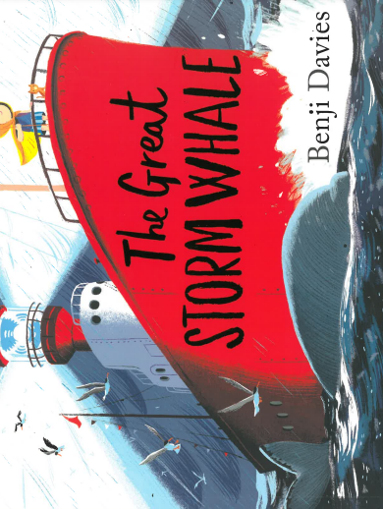
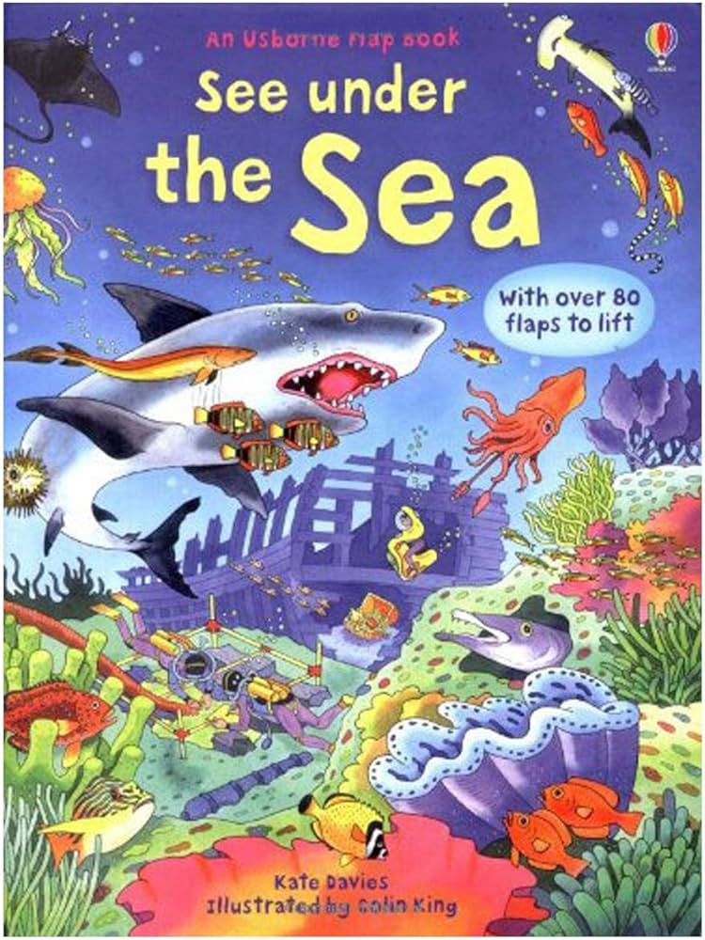
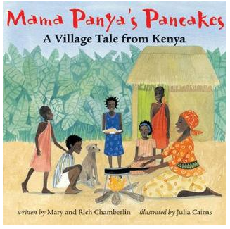
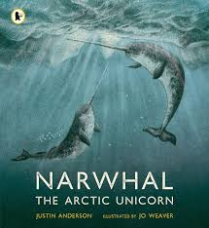
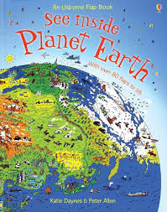
Summer 1: Extreme Environments Y2
Key books this term
The Great Storm Whale
Narwhal The Arctic Unicorn
See under the sea
Mama Panya’s Pancakes
See Inside Planet Earth
Key Questions?
What do Polar bears eat?
What animals live in the Arctic?
How are the animals adapted for the environment they live in?
-What will happen if all the ice melts?
Why do the narwhals need to take quick breaths?
What dangers do they face?
Key Vocabulary:
Barren : an area of land overgrown with dense forest and tangled vegetation, typically in the tropics
Sahara desert: this is a place in Africa and is the hottest place on earth.
Oasis: this is a patch in the desert where plants can grow because there’s water.
Glaciers: these are rivers of ice that travel very slowly downhill. They carve out the rock along the way.
Icebergs: where ice melts away in large chunks and float away.
Key Questions:
Why is Antarctica classed as a desert?
What animals will you find in the desert?
How do plants and animals cope with little water in the desert?
Why is Antarctica melting?
Why do scientists go to Antarctica?
How to animals adapt to live in this extreme places?
Key Vocabulary:
Extreme environment: an extreme environment is a habitat that is considered very hard to survive in due to its considerably extreme conditions such as temperature, accessibility to different energy sources or under high pressure adjusted to new conditions.
Howled: this is an adjective to describe the wind. It means the wind is very strong and powerful.
Glistening: Something that’s shiny with a shimmering light.
Key Questions?
Why did the whales not return in the summer?
What materials did the whales find in the ocean?
Why did the family have to leave their home?
How did the family keep each other warm in the ship?
How did Noi feel when the whales returned?
Key Vocabulary:
- Arctic Ocean: this is the coldest ocean in the world. In the middle of the Arctic is the North Pole. It is covered in ice all year round.
- Shoal of krill: these animals look like shrimp, but they’re much smaller. They feed on algae under the sea ice.
- Blowholes – whales don’t breathe through their mouths, but through blowholes on the tops of their -heads.
- Abyss: when the light in the ocean trickles out altogether, you reach the abyss.
- Trenches: this is even deeper than the abyss. Deep trenches plunge down into darkness.
Key Questions:
Why is it hard for animals to survive in the Arctic?
What animals would you expect to find in the North Pole?
What do blue whales eat?
How do poplar bears keep warm?
What animals would you find in the abyss?
Who explored the deep trenches?
Why is it hard for animals to survive in the abyss?
Key Vocabulary:
Baobab tree: this is a large tree, often called the tree of life, because it stores so much water.
Kiswahili: Kenyans speak many languages, but the main ones are Kiswahili and English.
Drinking-gourds: In Kenya, people store milk in gourds. This is common on Kenyan tribes.
Thumb piano: this is a small instrument which can be played with the thumbs.
Key Questions:
Who did the main characters meet on their journey?
What ingredients are in the pancakes?
What animals are in the story?
How do the animals adapt to the heat?
What was being sold at the markets?
Why are the pancakes special?
Key Vocabulary:
Narwhal: these are toothed whales, related to killer whales and dolphins. They can reach 5 meters in length and weigh 1,800kg.
Arctic: this is located in the north of our planet. It is often called the North Pole.
Pod – the name for a group of narwhals.
Echolocation – narwhals use clicking in the dark to help them navigate.

Slide 2
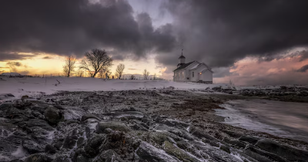
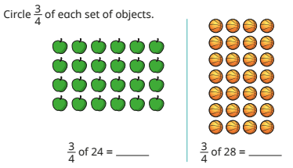
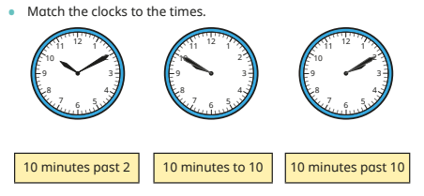
Science
Mathematics – Fractions and Time
.
Geography
This term we will look at living things. We will learn that most living things live in habitats to which they are suited and describe how different habitats provide for the basic needs of different kinds of animals and plants and how they depend on each other.
We will identify and name a variety of plants and animals in their habitats, including microhabitats.
We will describe how animals obtain their food from plants and other animals, using the idea of a simple food chain, and identify and name different sources of food.
The children will also recap the common characteristics of all living things - movement, respiration, sense, growing, reproduction, excretion and the need for nutrition.
Children will learn about ‘whole’ and ‘parts of a whole.’ They will learn to identify ½ ¼ and ¾ of an amount and object.
DT
The children will continue developing their textile skills, this time by using fabric and a loom to weave.
Children will learn to tell the time to o’clock, half past, quarter past, quarter to and to the 5 minutes past the hour
The children will be learning how to use simple compass directions (North, South, East and West) and to name and locate the world’s seven continents and five oceans. They will also be able to identify hot and cold areas of the world in relation to the Equator and the North and South Poles.
Vocabulary
Direction, left, right, forwards, backwards, north, south, east, west, compass, Earth, Globe, Asia, Europe, Africa, North America, South America, Australia, Antarctica, Pacific, Atlantic, Indian, Southern, Arctic, North Pole, South Pole, Equator.
RE
The children will be learning more about Christianity this half term and more specifically the ‘good news’ that Christians believe Jesus brings. Children will be encouraged to respond sensitively to other people’s beliefs.
AT HOME::Practise your KIRFs (Key Instant Recall Facts)
AT HOME: Explore your local environment and try to spot as many different habitats as you can. Maybe you can work out how each animal has adapted to where they live.
RSHE
Art
The children will produced a mixed media collage using the theme ‘Extreme Environment’ as inspiration.
English
Handwriting
We will continue practising letter formation and the positioning of letters using our handwriting lines. This will include letter joins. It is important that the children form their letters correctly as this can be the difference between working towards the expected standard or working at the expected standard at the end of the year.
Jigsaw We follow a scheme called Jigsaw to focus on PSHE and RSHE in Year 2. The topic focus this half term is Relationships. The children will be working on friendships, showing and treating each other with respect and how to work through problems.
Reading
Please continue to practise reading regularly at home. It doesn’t matter what the reading material is- comics, leaflets, books, poetry etc. It all counts. School reading books will also be sent home.
We aim to promote a love of reading in school and all of our learning comes from quality books.
Writing
In Year 2 this term, we will be reading “The Storm Whale.” We will study the story structure so that we can retell and innovate the story..
The children will look at the structure and language used in the story. We will learn to write in sustained, sequences sentences to form paragraphs. We will learn to use past tense and write in third person consistently. The children’s retell and innovation will include setting and character descriptions and will include some dialogue and phrases drawn from story language to add interest. We will learn to use exciting story language and descriptive phrases and even similes.
Computing
Music
During the summer term the children will:
To use ‘higher’ or ‘lower’ to describe sounds
To pitch-match simple phrases
To explore vocal timbre
To use graphic notation to represent pitch
To play ascending and descending melodies on tuned percussion
To sing pentatonic songs. To begin to recognize pentatonic scales.
In this series of lessons the children will extend their knowledge of programming floor robots, e.g. Bee-Bots and create more complex programs to draw numbers and create a robot dance. They will learn more about algorithms and programs, and use logical thinking to plan out algorithms to solve given problems.

Slide 3
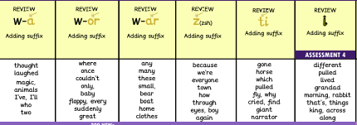
These are the sounds and words that your child should be able to read by the end of this half term. The e-book titles correspond to the sounds and words taught each week. These words will also be the weekly spells that will be checked on a Friday.
Year 2 Summer 1
Week 1 | Week 2 | Week 3 | Week 4 | Week 5 | Week 6
E-book Titles | Review The witch factor Swans | Review The magic words | Review Miss Oh No and the magic wardrobe | Review Television Treasure land | Position for a taxi | Review Wild explorers The tiger

Slide 4
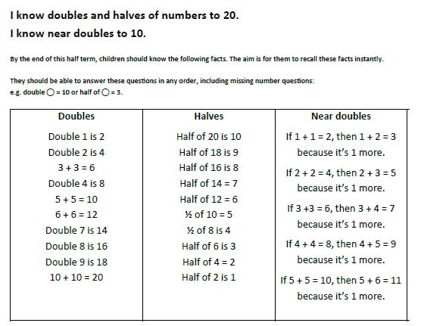
Key Instant Recall Facts
Year 2 | Summer 1
Top tips
The secret to success is practising little and often. Use time wisely. Can you practise these KIRFs while walking to school or during a car journey? You don’t need to practise them all at once: perhaps you could have a fact of the day.
Songs and Chants – The children should know a chant for doubles to ten or there are chants online.
https://www.youtube.com/watch?v=At0quRa90rs – doubles song
https://www.topmarks.co.uk/maths-games/daily10 Level 2 - Doubles and Halves
https://www.topmarks.co.uk/maths-games/hit-the-button - Doubles/Halves
https://www.bbc.co.uk/bitesize/articles/zrws47h - near doubles

